Slide 1
BLU-PATH : Embedded Web-Based Indoor Navigation System
SILICON LABS BRD2605A · WISECONNECT SDK · OFFLINE · NO APP REQUIRED
Author
Jerlin Jeba MJ
Ilakkiya V
Kanishka M
Riyash M
Ramprasath V

Slide 2
Problem Statement
Visitors entering large campuses such as colleges, hospitals, and corporate buildings often struggle to locate specific departments, labs, offices, or service centers. GPS-based navigation works well outdoors but fails completely inside buildings because signals are blocked by walls and ceilings. There is no self-service indoor wayfinding solution available in most campuses, forcing visitors to depend on staff for directions — which wastes time and increases operational burden.

Slide 3
Objectives
The goal of BLU-PATH is to provide reliable campus-level indoor navigation without depending on GPS or internet connectivity. The system hosts a navigation webpage directly on the BRD2605A embedded board, allowing visitors to access it instantly by scanning a QR code. It displays interactive campus maps and destination-specific route information, operates fully offline, and improves the overall visitor experience without requiring any mobile app installation.

Slide 4
Proposed Solution
BLU-PATH uses the Silicon Labs BRD2605A board configured as a standalone Wi-Fi Access Point and embedded HTTP web server. When a visitor enters the campus, they scan the BLU-PATH QR code placed at the entrance. Their smartphone connects to the local Wi-Fi network, and the navigation portal opens automatically in the mobile browser. The user selects a destination from the campus directory and receives a route map along with navigation instructions — all served locally from the embedded device, with no internet or app required.

Slide 5
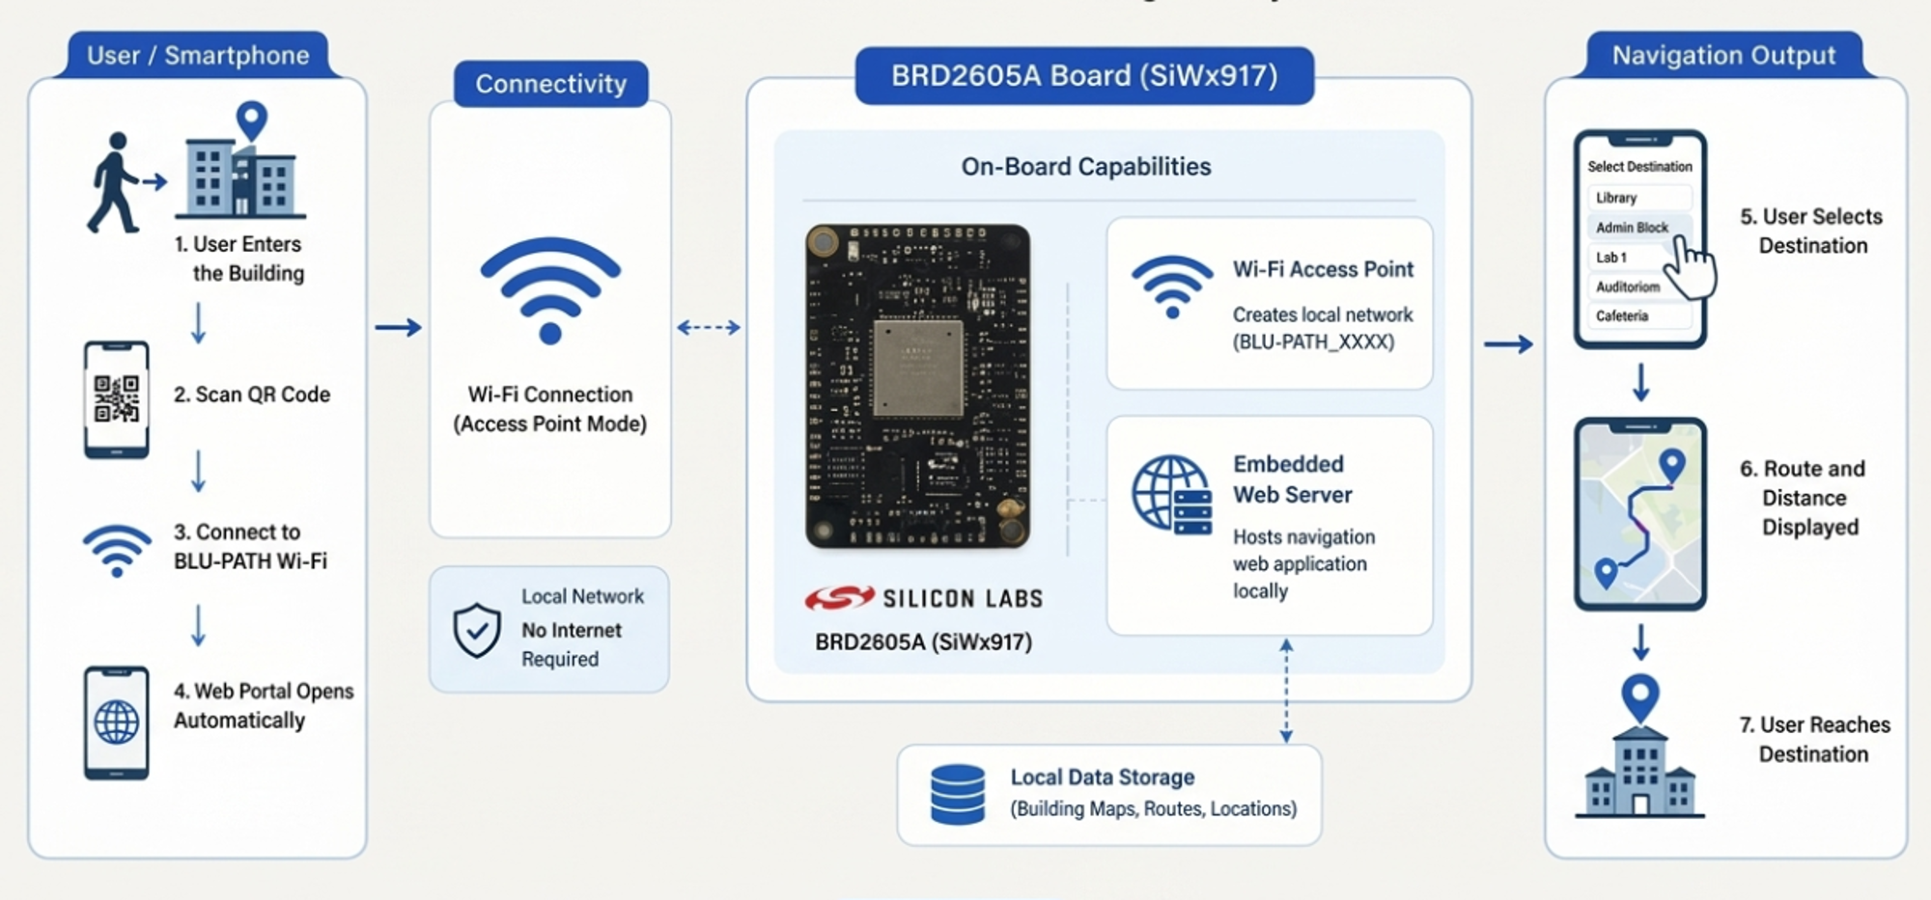
Block Diagram

Slide 6
Hardware & Software Requirements
Hardware:
Silicon Labs BRD2605A (SiWx917) Development Board
USB Power Supply
QR Code Display Board
Visitor's Smartphone / Tablet
Software:
Simplicity Studio IDE
WiseConnect SDK
Embedded HTTP Server
HTML · CSS · JavaScript
Wi-Fi Access Point Configuration

Slide 7
Working Principle
BRD2605A boots as Wi-Fi Access Point named "BLU-PATH"
Visitor scans the QR code at campus entrance
Smartphone connects to BLU-PATH Wi-Fi network
Embedded web portal opens automatically in browser
User selects desired destination from campus directory
System displays route map and turn-by-turn guidance
Visitor reaches destination independently

Slide 8

Results & Demo
Future Enhancements :
BLE Beacon Integration for real-time positioning
Multi-floor & large campus support
Dynamic route updates (congestion-aware)
Cloud + Mobile App companion
BLU-PATH.mp4
Source Code: GitHub
Scan to find the destination

